Slide 1


Project analysis slide 2
EXL EQ - 2021 Team : Data Miners
Indian Institute of Technology, Kharagpur
1. Data Insights to find Regression Model
using missing data and correlation analysis
6. Additional Variables to effectively model
confirmed cases
Executive Summary
2. Data Insights to find Time Series Model
by plotting confirmed cases versus date
5. Vaccine Distribution Strategy based on
severity of cases & transportation cost
3. Create Final Model by combining the
previous models [ 1 and 2].
4. Forecasting future cases and identifying
worst affected states

Slide 2
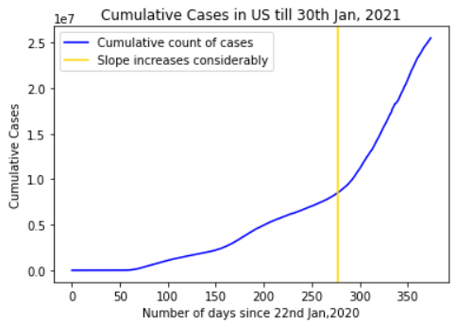
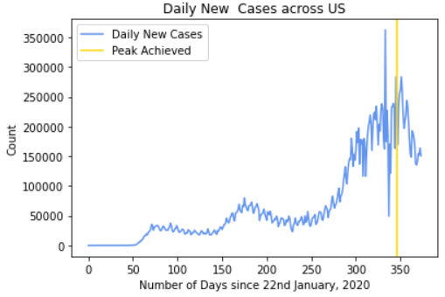
Data Insights
Correlation analysis
(Taken mean across counties)
Missing Data Analysis for variables having significant correlation
Conclusion from Correlation and Missing Data Analysis
Due to strong positive correlation between confirmed cases and test count we have selected test count as the independent variable for our regression model { discussed in next slide}
Variables | Percentage of Missing Values
International Air Passengers | 30 %
YoY Reopened Seated Dinner Data | 80 %
Variables | Correlation Value
Confirmed cases and test count | 0.956
Confirmed cases and deaths | 0.939
Graphical Analysis
The peak in daily cases was achieved around 8th January, 2021 and after that cases have been decreasing all over USA .
There was a significant increase in cases around 1st November, 2020
Number of Daily Cases was plotted against Days
Cumulative Count of Cases plotted against Days

Slide 3
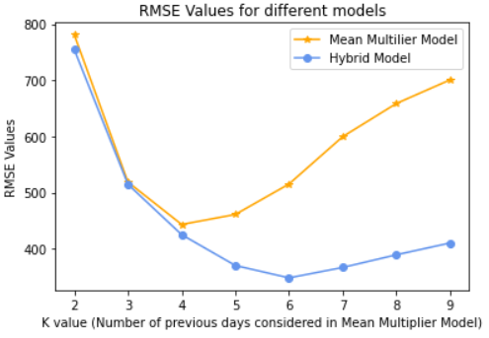
Modelling Confirmed Cases
Model 1
Model 2
Final Model(Hybrid Model)
Linear Regression Model
C_{i}= b₁* Test Count_{i} + b₀
[C_{i}=Cases on i^{th} day]
Estimate b₁ and b₀ through
least square method.
Time Series (Mean Multiplier) Model
C_{i} = m_{i} * C_{i-1}
[C_{i}=Cases on i^{th} day]
Estimate m and k:
m_{i} = (m_{i-1}+m_{i-2+}m_{i-3…}m_{i-k})/k
0.9* Pred. Value from Model-2 (with k=6) + 0.1 * Pred. Value from Model-1
(County Wise, i.e. different Regression model for different County).
Thus, C_{i} = f( Test Count_{i} ,C_{i-1}, C_{i-2,} C_{i-3},….C_{i-k})
Validation Results
Top Drivers of Model
Test Count_{i} :Used in Regression Analysis
[Addressed through Model-1]
Asymptomatic Cases: The New Cases are mostly due to Asymptomatic people. [Addressed through Model-2]
Virus Incubation Period : Cases which have been confirmed after 5-6 days of contracting the virus [Addressed through Model-2]
Thus, Hybrid Model with K=6, has the Minimal RMSE value.

Slide 4
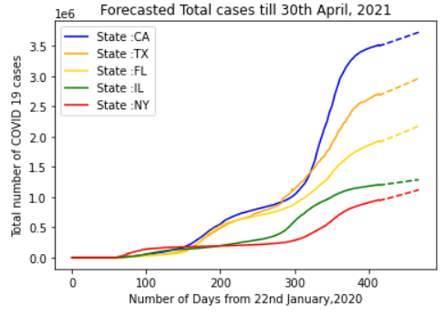
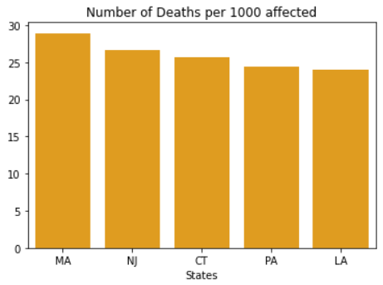
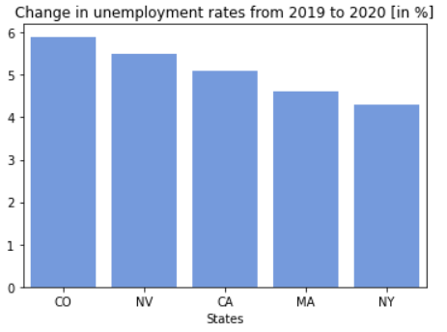
Top 5 States worst affected by COVID
Source: Centre for Disease Control and Prevention, US
Source: Bureau of Labor Statistics, US
Dashed parts are forecasted values for 5 states
Top 5 States according to case fatality rate
Top 5 States by increase in Unemployment rate
Top 5 States by total cases
Pandemic Severity Factor
Economic Impact Factor
Predicted Scenario
CALIFORNIA
ILLINOIS
CONCLUSION : The Top-5 States worst hit by COVID, are:-
MASSACHUSETTS
NEW YORK
TEXAS

Slide 5
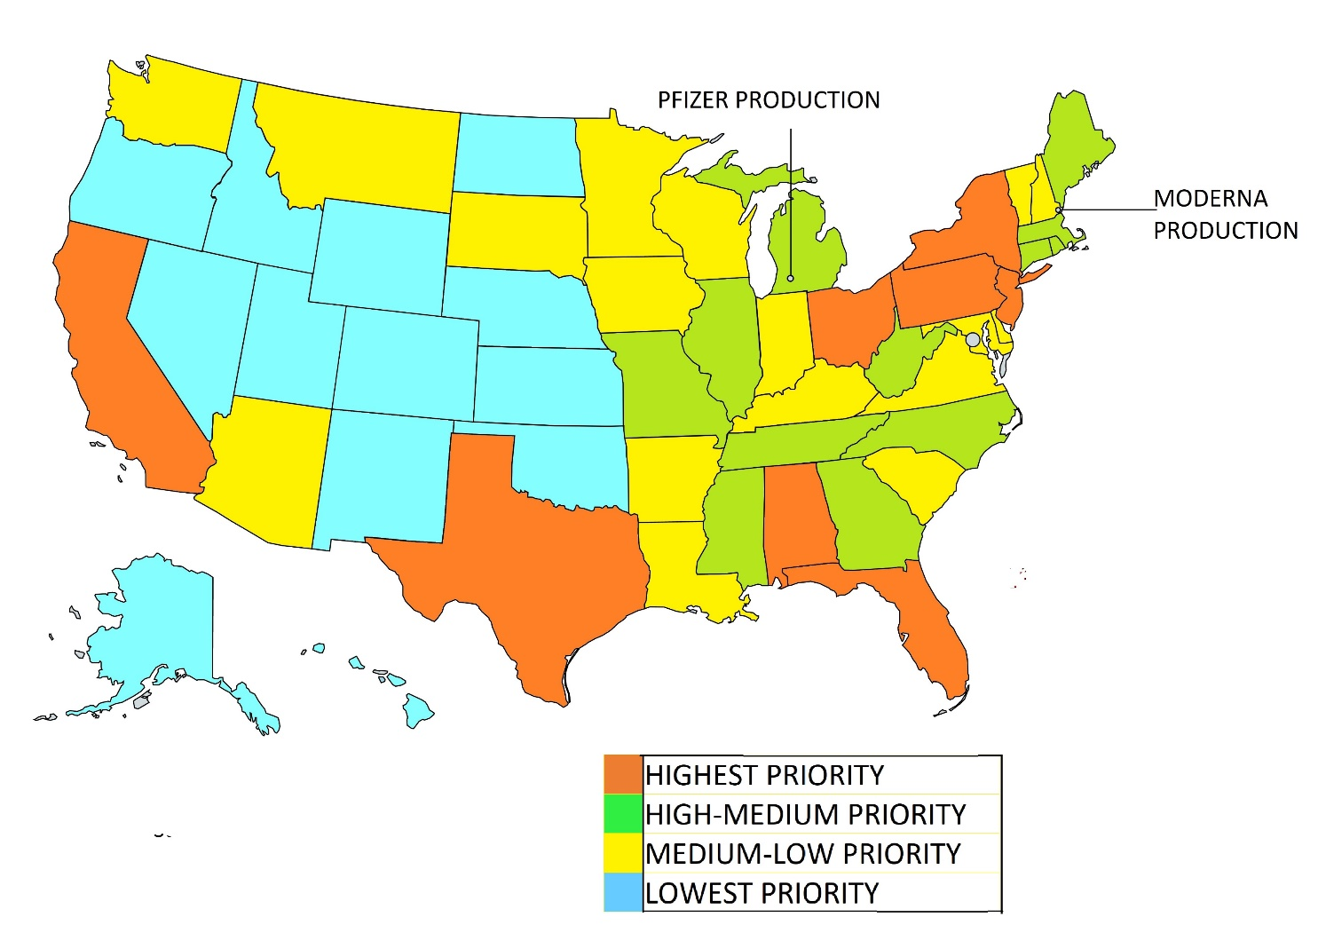
Priority Score Calculation to determine demand of each state
Calculate daily Covid Vaccine production in USA to determine the supply
Determining which states will receive Pfizer and which state will receive Moderna
Vaccine Distribution Optimization Strategy
Setting up huge cold storage in order to reduce transportation cost
Optimisting the routes based on supply-demand and transportation cost
P
P
1)DEMAND FACTOR
(PRIORITY SCORE)
Based on:
Total Population of state
No of frontline workers
Percentage of population above 60 years
Confirmed cases
Population Density
Technology available for cold storage
The Forecasted Demand of the Vaccines is directly proportional to the Priority Score for a State

Slide 6
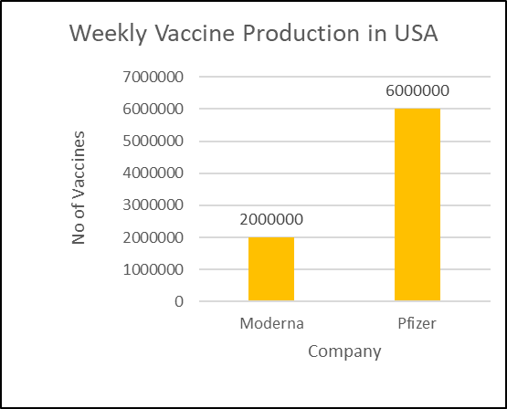
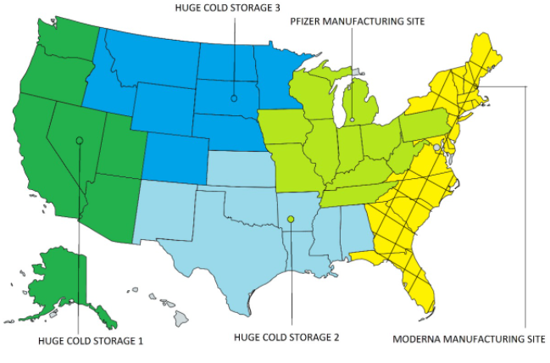
2)SUPPLY FACTOR
3) WHICH STATE WILL RECEIVE WHICH VACCINE
Vaccine | Demand | Supply
Moderna | 28% | 25%
Pfizer | 72% | 75%
DEMAND – SUPPLY MATCHING
TRANSPORTATION COST
4) COLD STORAGE SET UP AND 5) VACCINE DISTRIBUTION OPTIMISATION
Vaccine | Colour Code | Vaccine Demand of the states
Moderna |  | 28%
Cold Storages are proposed to be set up at centroid of each region
Colour Code | Mode of distribution of vaccines
Neighbouring states
Moderna site
Pfizer |  | 24%
Pfizer site
Neighbouring states
 | 16%
 | 16%
 | 16%
Pfizer site
Cold Storage
Neighbouring states

Slide 7
Additional Variables to be considered for predicting confirmed cases
1) Urban Population %
2) Persons in each household
3) People above 65 years
1) Percentage of smokers
2) People with comorbidities
3) Infant Mortality Rate
Environmental Factors
Economic Factors
Medical Factors
Mobility & Climatic Factors
Social Factors
1) C02 ,NO2 emission
2) PM2.5 Concentration
1) GDP per Capita
2) Govt. Expenditure on Healthcare
1) Inbound Tourism
2) Wind ,Temperature

